Slide 1

Understanding Customers and Consumers
Dr Jenny Lloyd
Associate Professor in Marketing
Term 1

Slide 2
Session objectives
By the end of this session you will:
Be able to distinguish between a ‘customer’ and a ‘consumer’
Have reviewed the primary drivers of customer/consumer choice.
Have reflected upon the process of decision making B2B and B2C contexts
Have considered the range of influence upon customer and consumer choice and the drivers of satisfaction

Slide 3
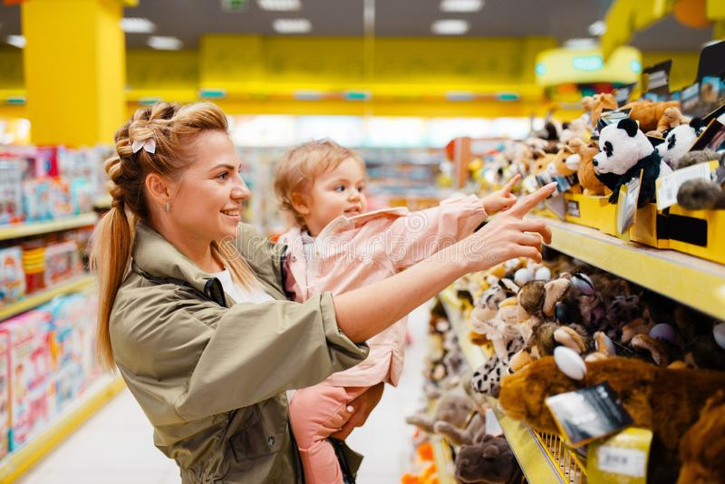
Get your Mentimeter app ready…
Are you looking at ‘customers’ or ‘consumers’?

Slide 4
What is the difference between a ‘customer’ and a ‘consumer’?
Definitions of ‘Customer’
The party which acquires, or agrees to acquire, ownership (in the case of goods)
or benefit or usage (in the case of services) in exchange for money or other
consideration under a contract of sale.
Professional purchaser specialising in a specific group of materials, goods or
services and experienced in market analysis, purchase negotiations, bulk buying
and delivery coordination.
Definitions of ‘Consumer’
The purchaser of a good or service in retail.
An end user, and not necessarily the purchaser in the distribution chain of a good or service.
Source: Businessdictionary.com

Slide 5
Why do consumers, consume?
Need
Desired End
State
(Goal)
Gap Creates State of Tension
Cognitive Dissonance
‘Homeostasis’ is achieved when the tension is resolved

Slide 6
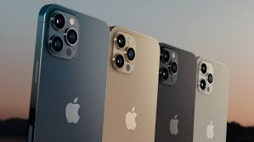
It’s a journey… a customer journey that starts with ‘cognitive dissonance’.
Problem Recognition
(Need vs Opportunity)
Why did you buy your last phone…?

Slide 7
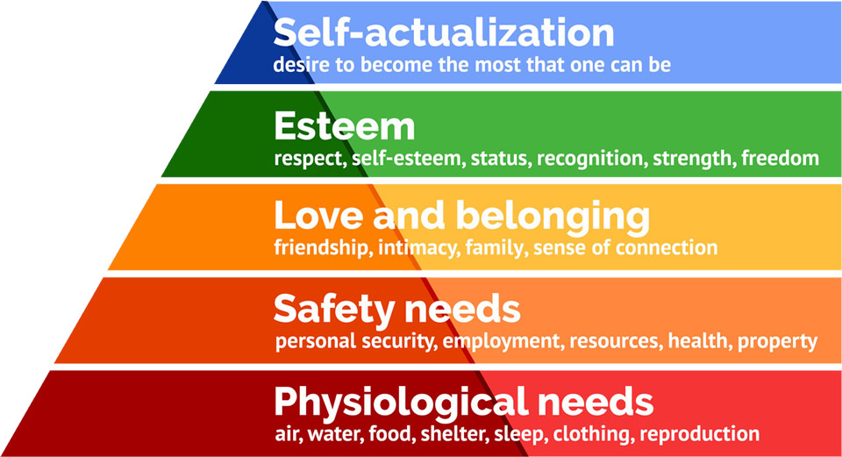
Maslow’s Hierarchy of Needs (1943)

Slide 8
Maslow – is it a model for the 21st century? (de Mooij 2004)
As a list of need types, there is still relevance
The prioritisation of physical and safety needs over non-physiological issues still stands.
BUT
Cultural differences are likely to affect the order of the non-physiological need types.
‘Self actualisation’ highly subjective
In collectivist cultures:
the self is less important than the honour of the ‘in group’
Safety and belonging merge as one is seen as the result of the other

Slide 9
Other ways of classifying needs…
Types of needs
Biogenic
Psychogenic
Hedonic
Utilitarian
THESE ARE NOT MUTUALLY EXCLUSIVE
(Solomon et al 2018)

Slide 10




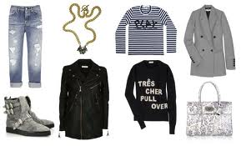
For each of these products, can you identify what kind of need(s) they satisfy?
What challenges does this highlight for marketers?

Slide 11

Motivation
“To understand motivation is to understand why people do what they do”
(Solomon, Bamossey and Askegaard 2013)

Slide 12
Motivational Theory
DRIVE THEORY
(Hull 1943)
Focuses on biological needs that produce unpleasant states of arousal
Tension
Homeostasis

Slide 13
Motivational Theory
EXPECTANCY
THEORY
(Vroom 1964)
Behaviour is pulled by expectations of achieving desirable outcomes
Behaviour
Reward

Slide 14
It’s a journey… a customer journey
Problem Recognition
(Need vs Opportunity)
Information Search
Evaluation of Alternatives
Product Choice
Evaluation of Outcomes
Stages in the Engel, Blackwell, and Miniard (1993) consumer decision making process model

Slide 15

Factors that influence consumer behaviour
Culture
Household type and family lifecycle
Self concept
Reference groups

Slide 16

Culture (Kotler et al 2019)
The fundamental determinant of a person’s wants and behaviour
The shared meanings of most people within a social group
Provide the blueprint for behaviour through shared norms and values

Slide 17

‘Family’ or ‘Household’ Decision Making…?
The ‘household’ is the basic consumption unit for most consumer goods.
Houses, cars, appliances are often consumed by households rather than individuals
Expenditure on one item within a household can divert funds from another (i.e. new kitchen vs holiday)
Hawkins and Mothersbaugh (2013)

Slide 18
Why is an understanding of the family so important? (Gilly and Ennis 1982)
The family life cycle has been an accepted indicator of consumption behaviour in sociology since 1936 and marketing since 1955.
Attitudes and behaviour tend to change over the course of an individual’s life
Key life events are more significant drivers of change than chronological age
“because the life cycle concept combines trends in earning power with demands placed on income, it is one of the most powerful ways of classifying and segmenting individuals and families”
Engel, Kollat and Blackwell (1978)

Slide 19
The Traditional Family Life Cycle
Three drivers of change
Relationship status
Bachelor
Honeymooners
Presence/
age of children
Full Nest
Age
Empty Nest
Sole Survivor
Adapted from Schiffman, Kanuk and Hansen (2011)

Slide 20
Self Concept: we are comprised of multiple selves (Onkvisit and Shaw 1987)
Solomon et al (2013)
Looking Glass self
‘How I’d like others to see me’
Ideal self
‘the good me’
Actual self
‘me as I am’
Extended self
‘Me as part of a wider group’
Negative self
‘That is SO not me’

Slide 21
‘Reference groups’………...
“an actual or imaginary individual or group conceived of having significant relevance upon an individual’s evaluations, aspirations or behaviour”
They are ‘identificational’
Linked directly with self concept
Solomon, Bamossey and Askegaard (2013)

Slide 22

Types of reference groups
Associative
Dissociative
Membership
Aspirational
Formal
Informal
Solomon, Bamossey and Askegaard (2013)

Slide 23
Summary
Consumers and customers are not necessarily the same thing
Customer/consumer choice is influenced by a number of internal and external forces
In marketing, it is important to understand not only the processes that customers and consumers go through when making decisions but also the influences upon those choices.
This understanding allows them to create products and services that not only address the needs of the customer/consumer but also formulate other aspects of marketing strategy, for example, communication and distribution strategies

Slide 24
References
Robinson, P.J., Faris, C.W. and Wind, Y., 1967. Industrial buying and creative marketing. Allyn and Bacon.
Webster Jr, F.E. and Wind, Y., 1972. A general model for understanding organizational buying behavior. The Journal of Marketing, pp.12-19.
Bunn, M.D., 1993. Taxonomy of buying decision approaches. The Journal of Marketing, pp.38-56.
Armstrong, G., Saunders, J. and Wong, V., 2010. Principles of marketing. Person Global Edition.
Toktaş-Palut, P., Baylav, E., Teoman, S. and Altunbey, M., 2014. The impact of barriers and benefits of e-procurement on its adoption decision: An empirical analysis. International Journal of Production Economics, 158, pp.77-90.
Croom, S. and Brandon-Jones, A., 2007. Impact of e-procurement: experiences from implementation in the UK public sector. Journal of Purchasing and Supply Management, 13(4), pp.294-303.
Morris, A., Stahl, A. and Herbert, R., 2000. E-procurement: streamlining processes to maximize effectiveness. Luminant Worldwide Corporation, USA.
Makkonen, H., Olkkonen, R. and Halinen, A., 2012. Organizational buying as muddling through: A practice–theory approach. Journal of Business Research, 65(6), pp.773-780.
Simon, H.A., 1955. A behavioral model of rational choice. The quarterly journal of economics, 69(1), pp.99-118.

